Slide 1
You know What?
My Family ROCKS!!!

Slide 2
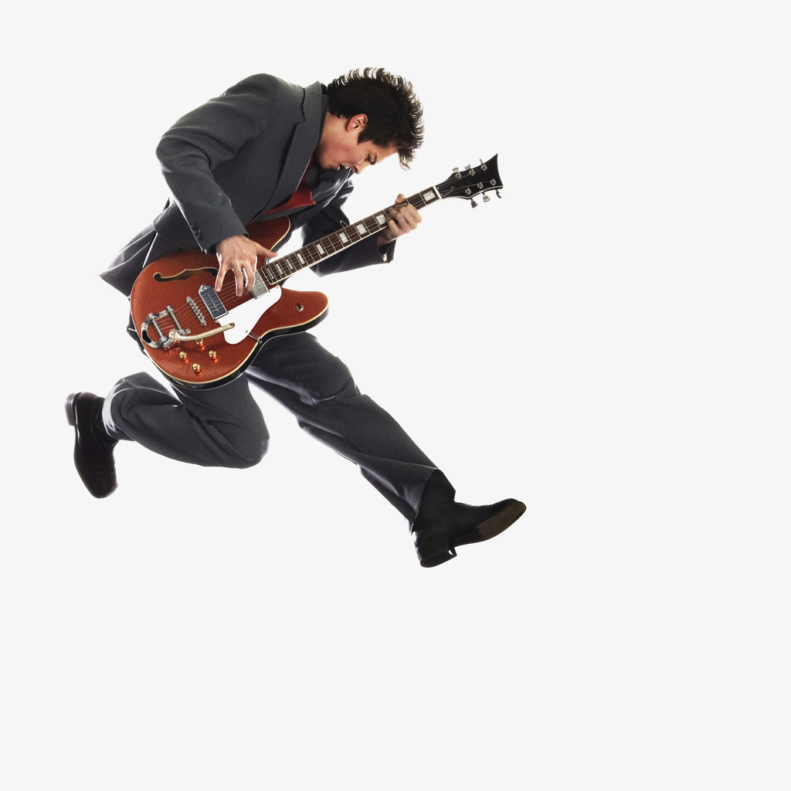
Do you know what else Rocks?

Slide 3
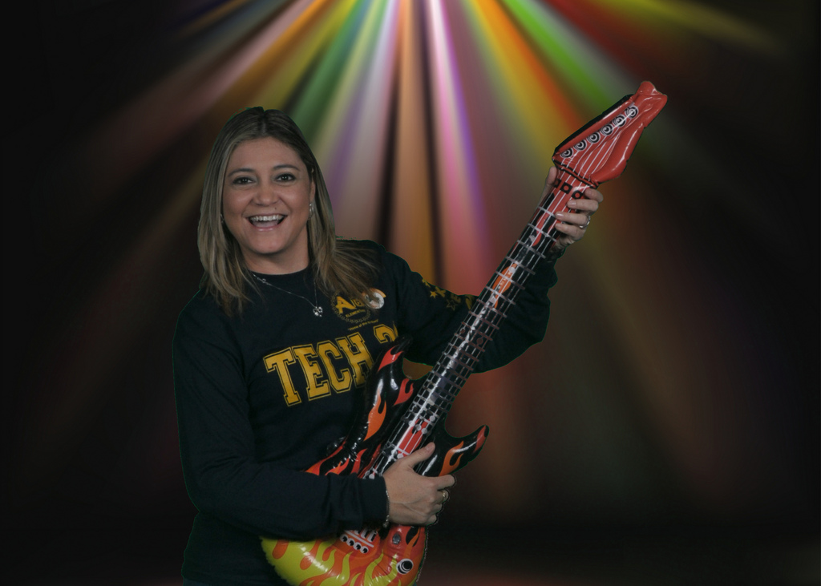
Technology Rocks!
By Ms. D. Cooper-Benavidez

Slide 4
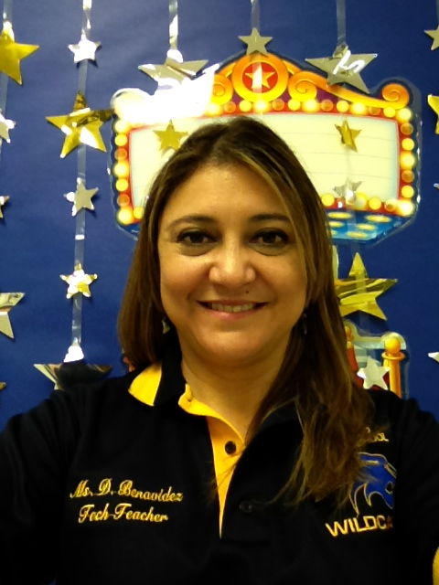
I really enjoyed my Tech Apps Class
During the 2012-13 school year at Besteiro Middle School!!!

Slide 5
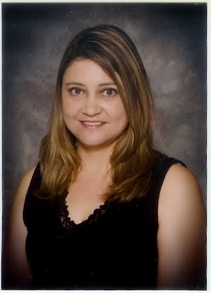
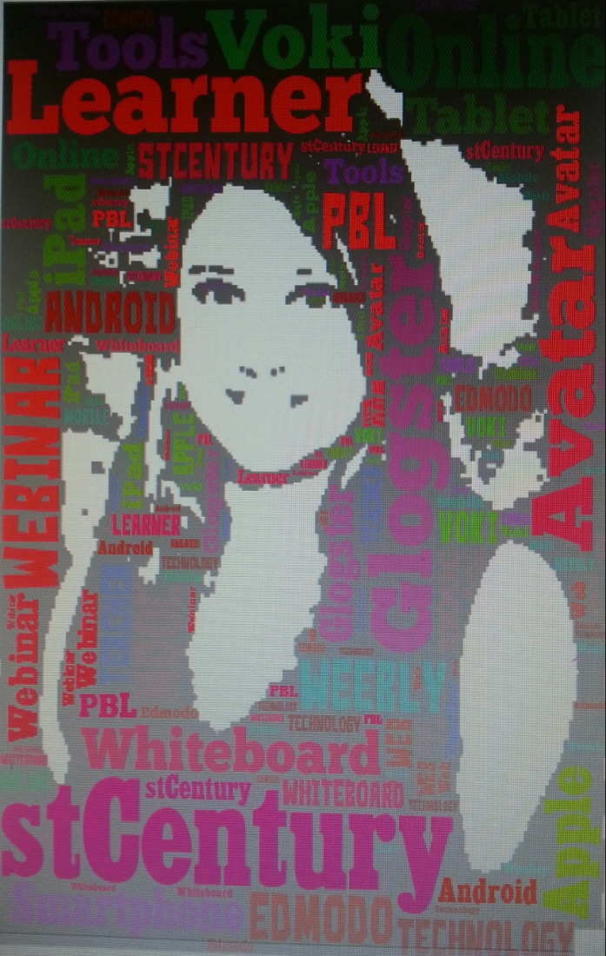
Microsoft Office & other Web 2.0 Tools!!!
We used Edmodo, Voki, Weebly, Glogster, Tagxedo, M

Slide 6
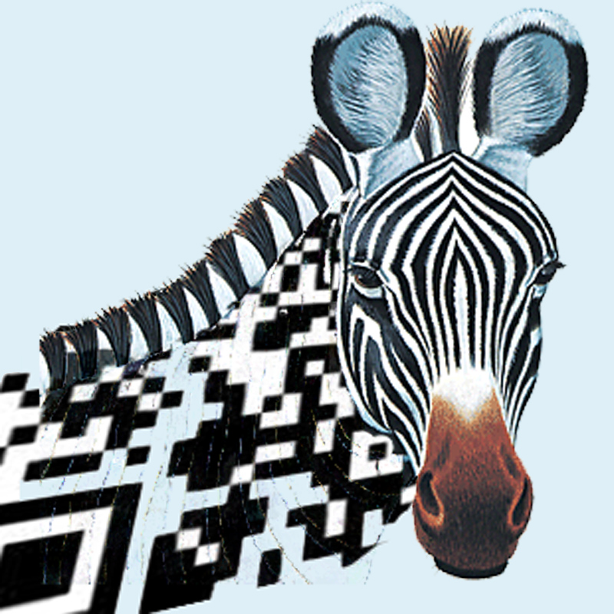
Let’s not forget QR Codes!

Slide 7
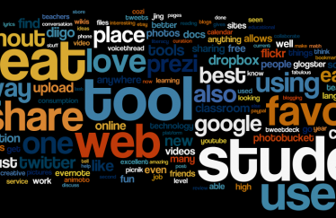
Which tool was your
F a v o r i t e ?

Slide 8
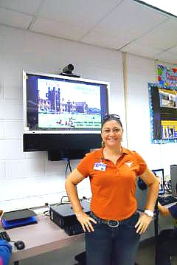
I LOVE getting my Students
ready for College and Beyond!

Slide 9
Do you wanna guess what else I Love?
Let’s see if after watching the next few slides you can figure it out ☺

Slide 10
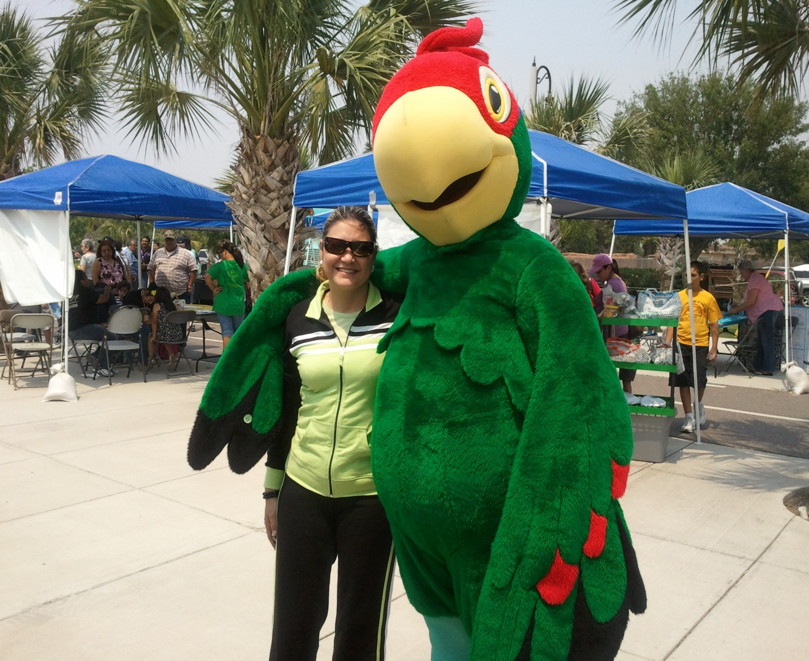
Brownsville’s Mascot

Slide 11
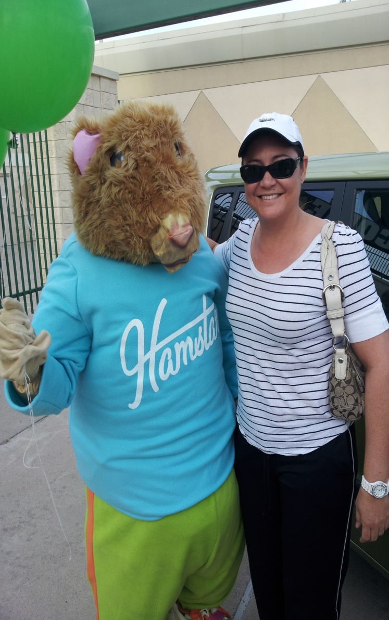
Kia Motors Hamster

Slide 12
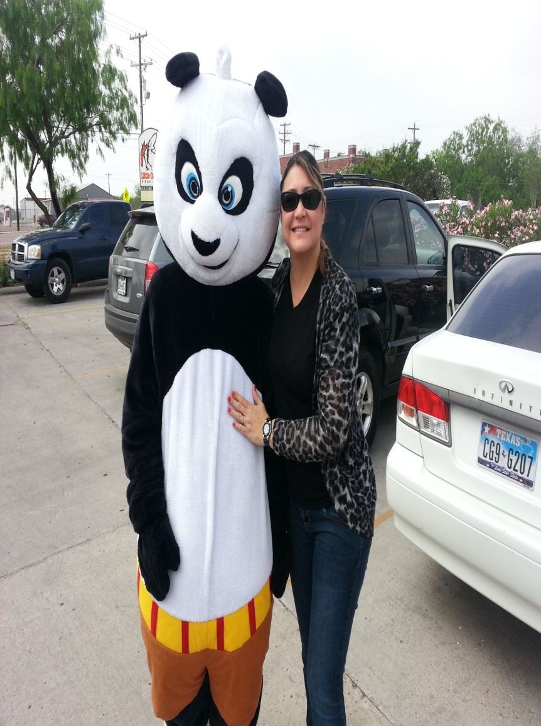
Kung-Fu Panda

Slide 13
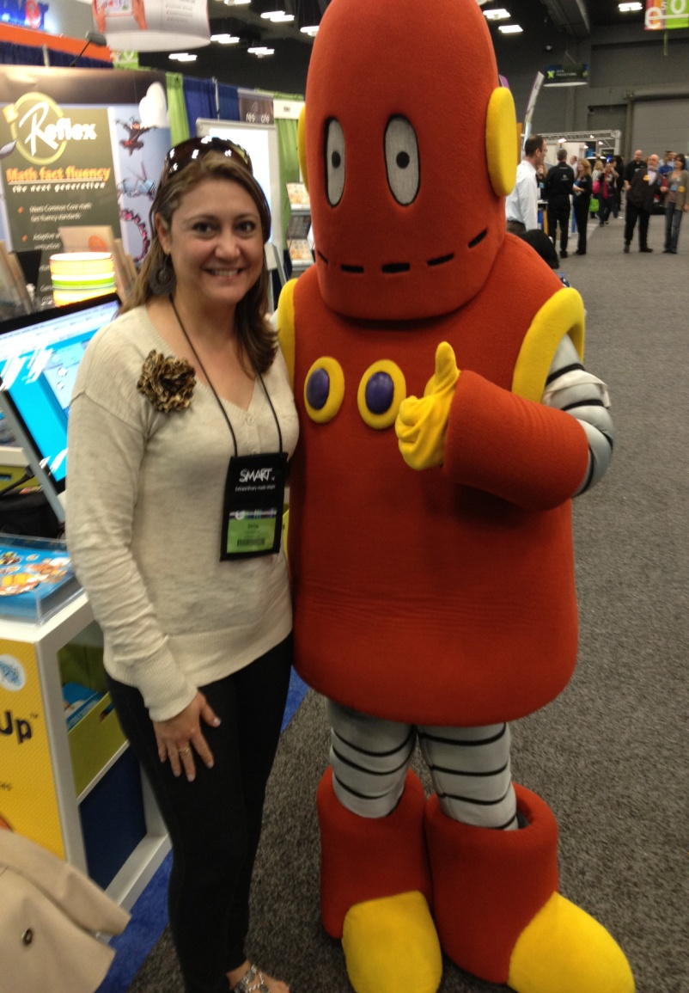
BrainPop’s Moby

Slide 14
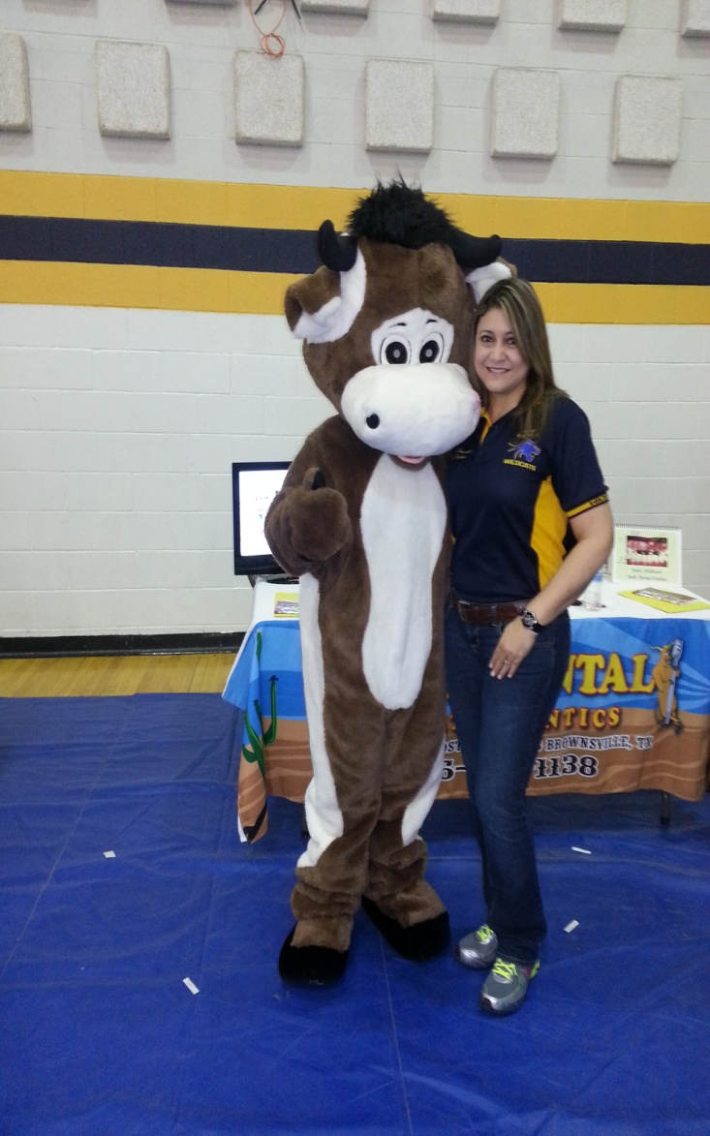
Rodeo Dental’s Mascot

Slide 15
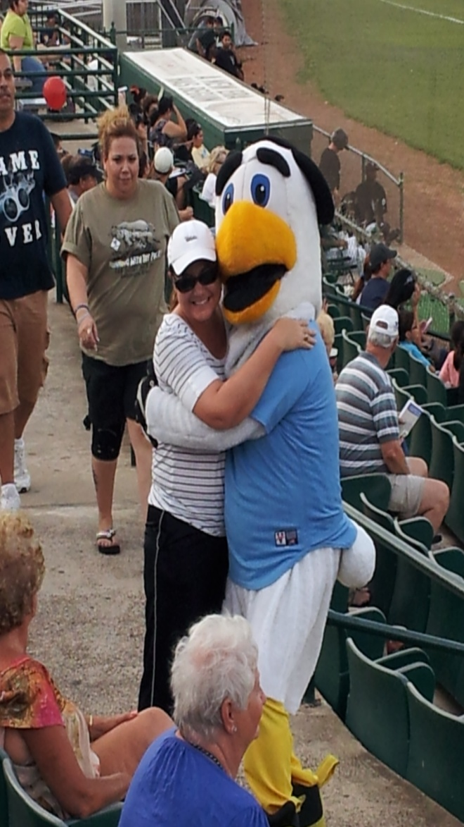
WhiteWings Mascot

Slide 16
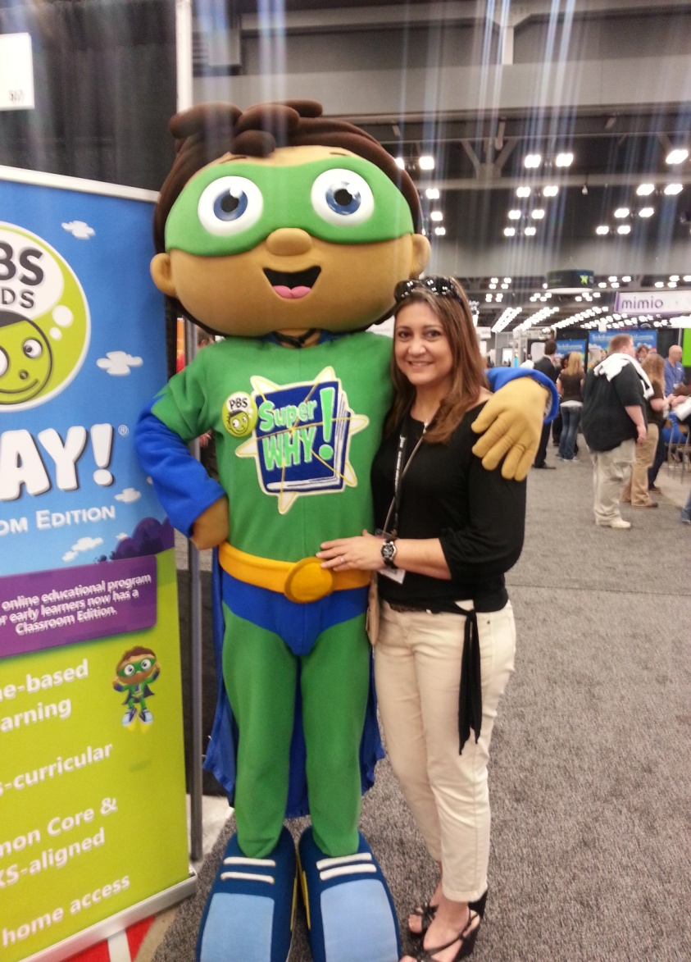
Super PBS Kid

Slide 17
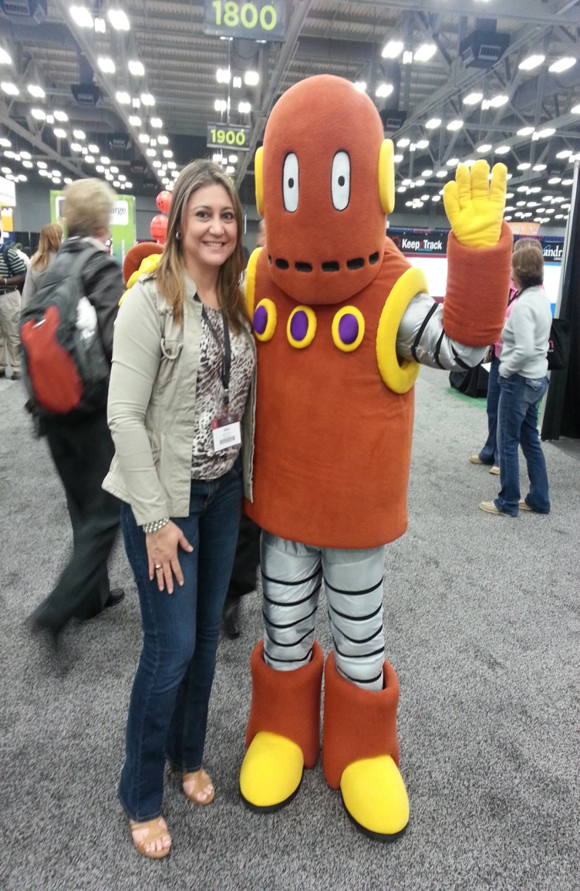
Moby & Me again!

Slide 18
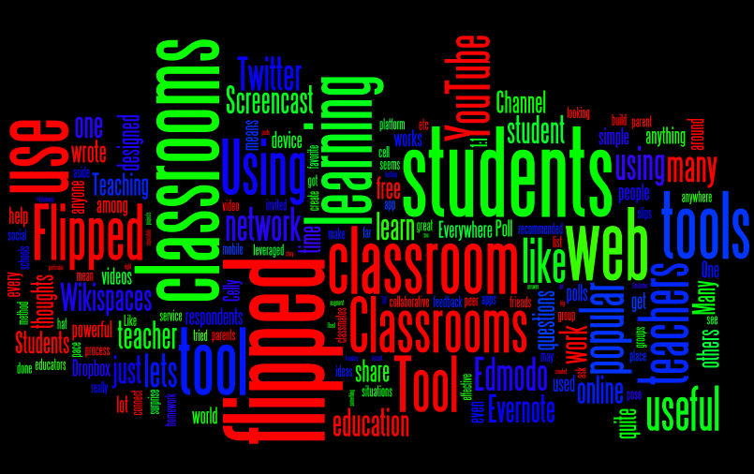
Enjoy using your Creativity
But remember everything I taught you and stay safe online ☺

