Slide 1
Comparing the Union and Confederacy

Slide 2
Union (Yankees)
Confederates (Rebels)

Slide 3
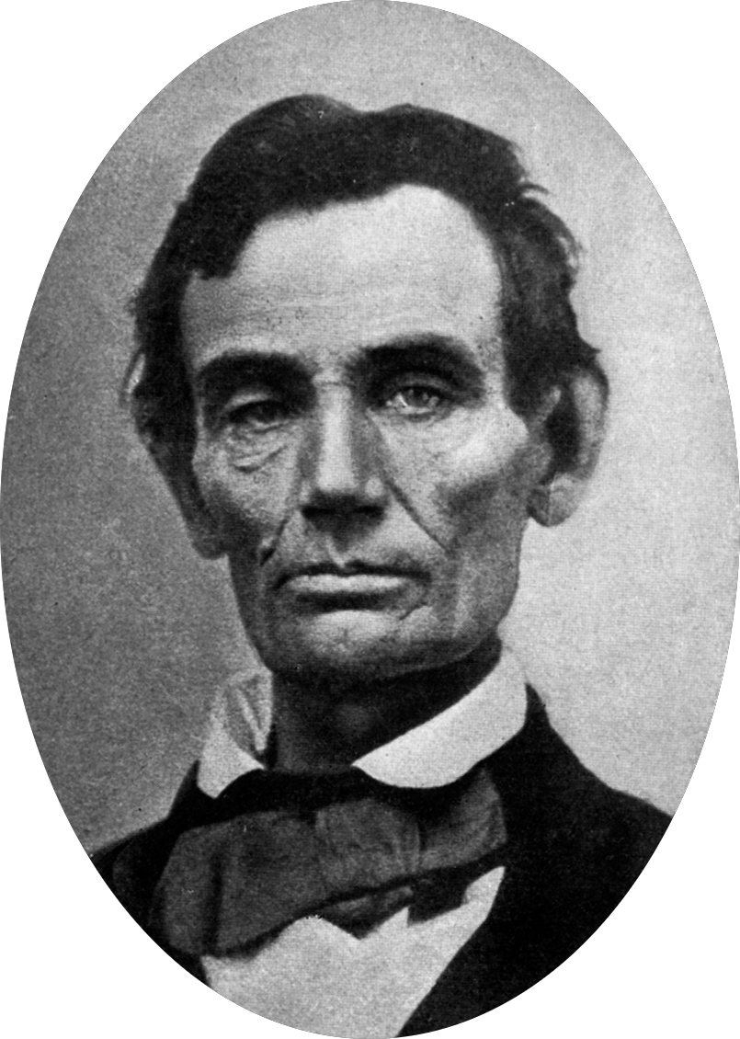
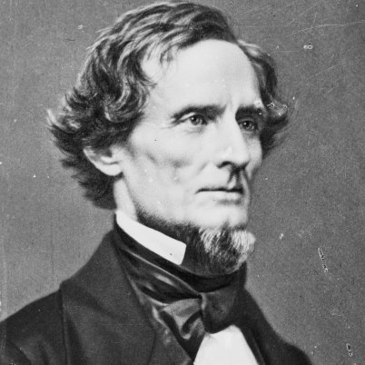
Leaders
Union
Confederates
Abraham Lincoln
Jefferson Davis

Slide 4
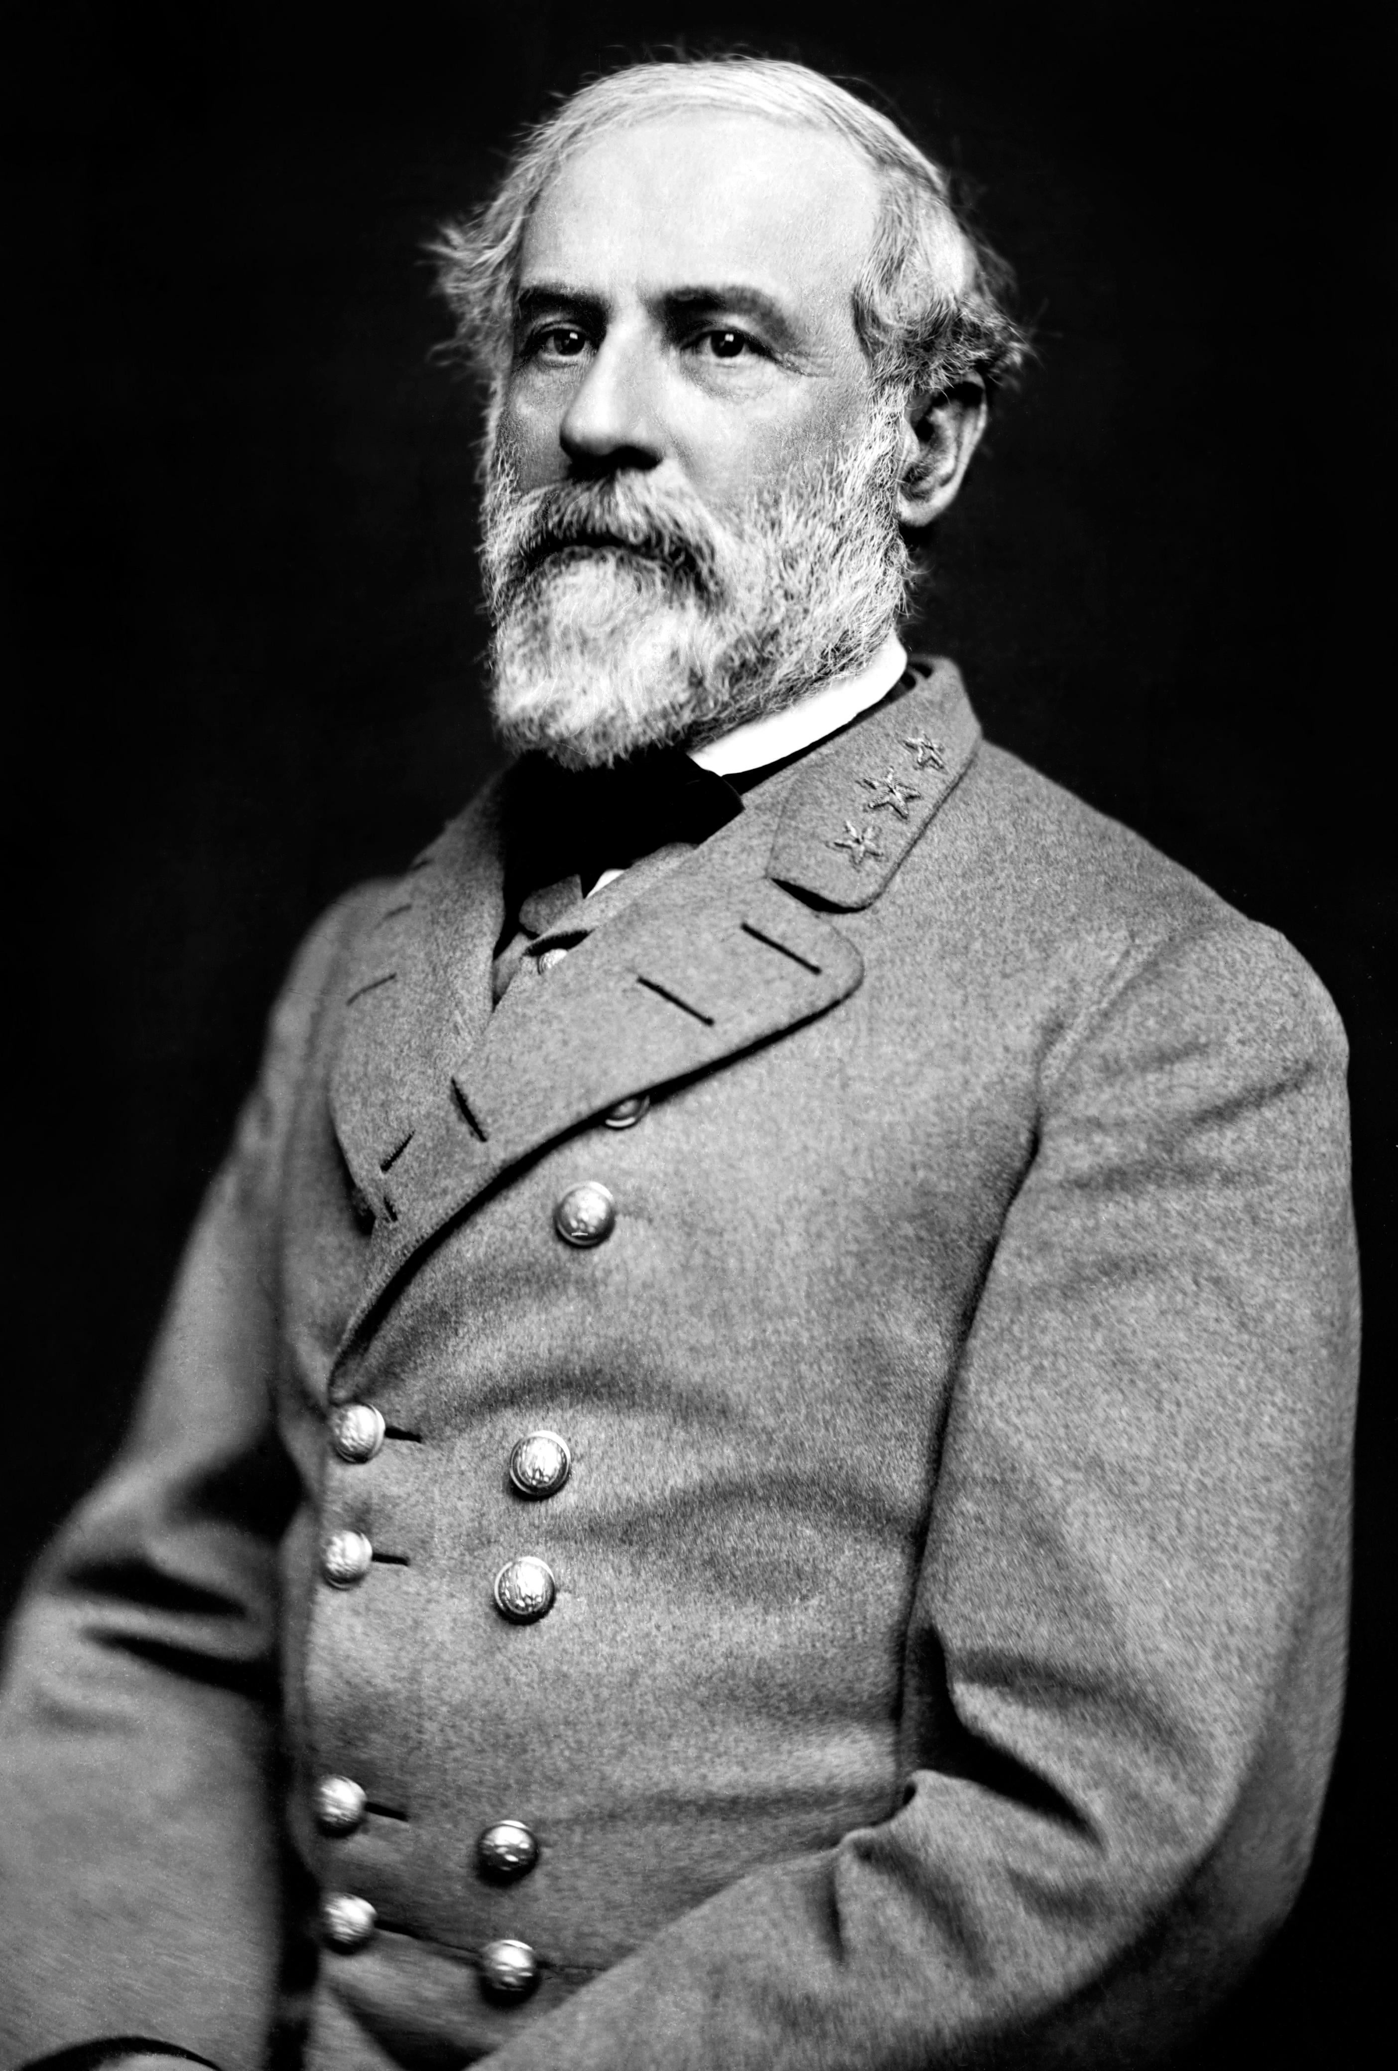
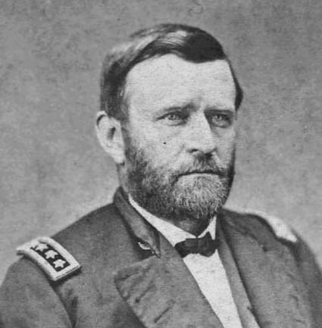
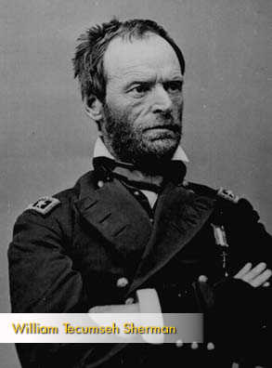
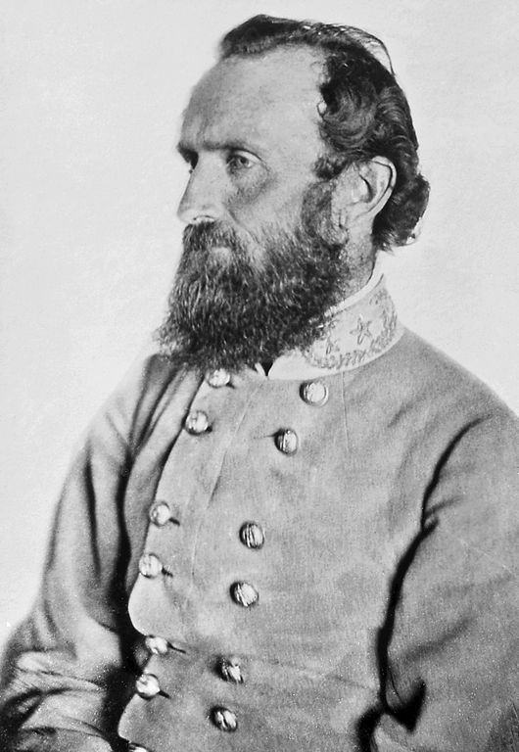
Generals
Union
Confederates
Ulysses S. Grant
George McClellan
William Tecumseh Sherman
Robert E. Lee
Stonewall Jackson

Slide 5
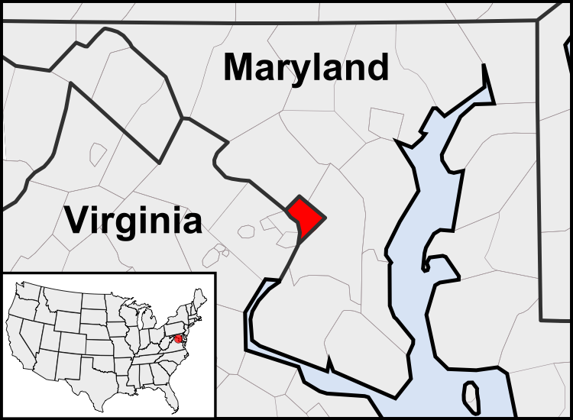
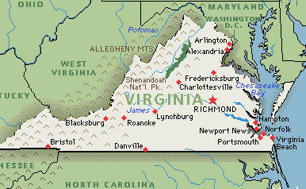
Capitals
Union
Confederates
Washington, D.C.
Richmond, Virginia

Slide 6
Advantages-Union
Large population
More industry (weapons, railroads, war supplies, etc.)
Lots of resources
Better banking system to raise money
More ships
Large and efficient railroad network
Lincoln as a leader

Slide 7
Advantages-Confederates
Strong support its white population gave to the war
Fighting on their own territory
Defending their way of life
Superior military leadership (at first) due to Southern military tradition

Slide 8
Disadvantages-Union
Difficult to bring Southern states back into nation
Has to invade the hostile South
Counter the South's support for the Confederate cause

Slide 9
Disadvantages-Confederates
Small population to draw upon in building an army
Few factories to manufacture weapons, etc.
Produces less food than the North; very few railroads, so difficult to deliver supplies to troops
States' rights belief prevents federal government from managing the war effectively

Slide 10
Goals
Union
Confederates
AT FIRST, bring the South back into the Union
LATER ON, end slavery
Win recognition as independent nation, so their way of life can be preserved

Slide 11
Strategy
Union
Confederates
1. Blockade Southern ports to prevent import and export of products
2. Gain control of the Mississippi River, cut supply lines, and split the Confederacy
3. Capture Richmond
Defensive strategy to hold onto as much of their land as possible until the Union tires
Expect British and French to pressure the Union to end the war

Slide 12
Troops
Union
Confederates
2.1 million men
850,000 men

